Slide 1
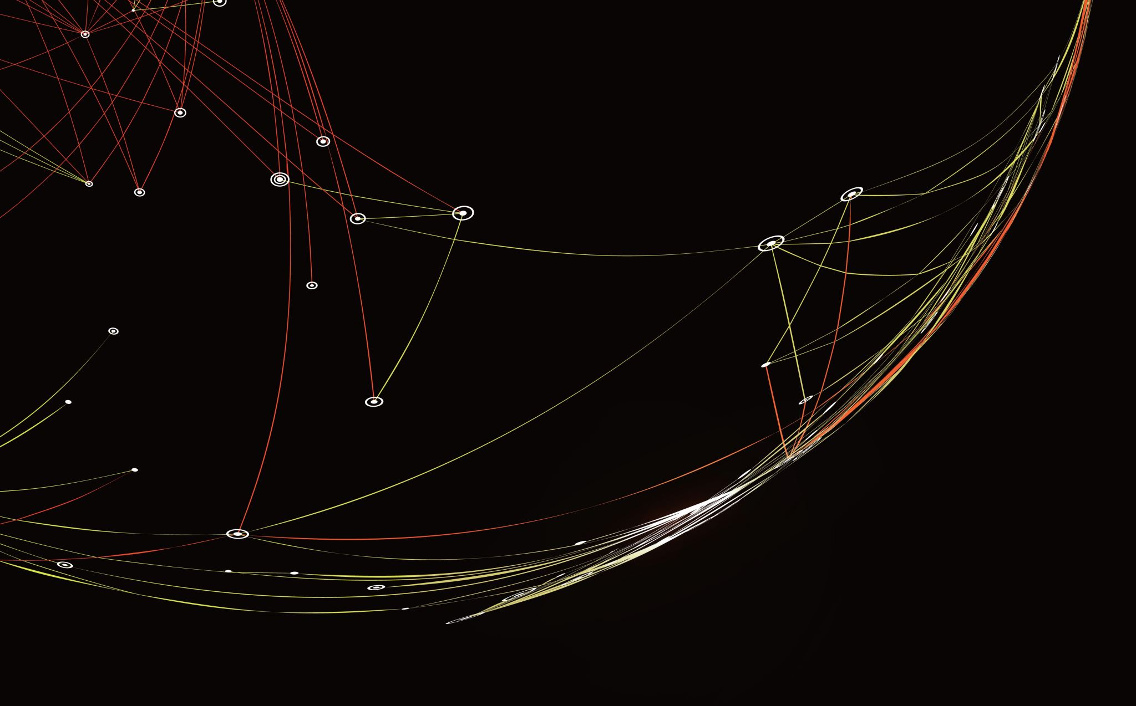
JavaScript
07.03.2024

Slide 2
Object
- object is

Slide 3
Jason

